Slide 1
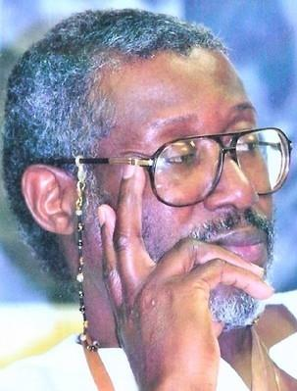
Honoring Nana Kobi K. K. Kambon
Cultural Redemption by Countering Injected Racial Scripts (CIRS)
By: Wekesa O. Madzimoyo
AYA Educational Institute

Slide 2
​Chapter 2 - The MAAFA and Afrikan Psychology
Our own intra-psychic / spiritual trauma lingering from the MAAFA experience

Slide 3
Discover the real connections we have to that MAAFA experience and story - both his-story and our-story of it.

Slide 4
Our cultural redemption depends on this analysis - returning to it psychologically and spiritually as a source of strength

Slide 5
Family ritual to read through the African captive narratives to seek a better understanding of what our ancestors went through to keep us grounded and reminded of our responsibility/accountability to them.
Notes:
Narratives: Stories
Grounded to what? For What?
What is our responsibility to them?
What are we to be held accountable for?

Slide 6
​Chapter 2 - The MAAFA and Afrikan Psychology
This is a vital link back to the deep well of our true Afrikan power base in Africa itself.

Slide 7
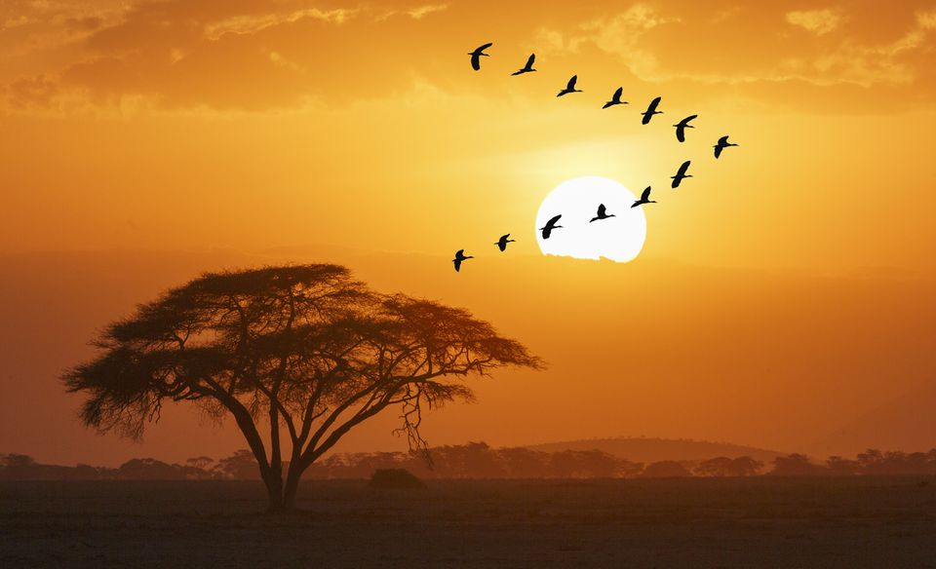
2 Mistakes:
1.We want to get back so fast we often skip the Afrika we recreated and created here to survive the MAAFA
2. We look at the “trauma” through our wounded eyes.

Slide 8
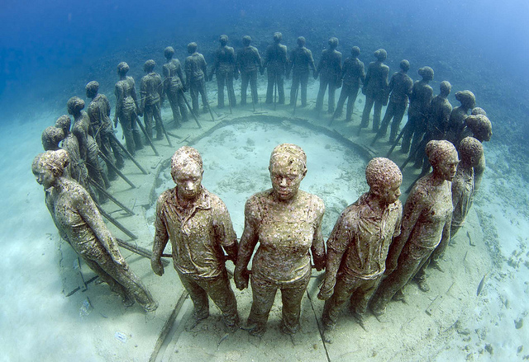
Circle of Culture

Slide 9
Memories (Circle of Culture)
Retain (Culture / History)
Regain (Culture, Sovereignity)
Resist (Oppression)
Reject (Anything that's anti ASCO)
Re-create / create (Afrika here)
Return (To keep the promise)
Notes:
Imagine that you're back home before the MAAFA. What are you doing? What do you remember? As you approach these shores and are forced into this hell, how will those memories serve you? High school students generated most of this list.

Slide 10
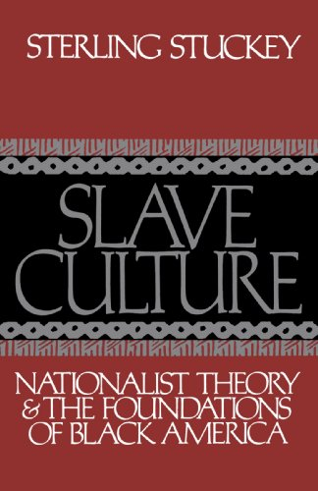
The Circle of Culture: Memories of Home - Our ways... Resistance - Warfare to Sarcasm to Sacrifice Spirit / Culture: Hidden Practices, The Ring Shouts, Blues, Spirituals, Art Storytellin -King Buzzard Rituals Bonding Agreements - One Afrika, Marriage, Kinship
Notes:
The Black Family in Slavery and Freedom, 1750–1925, published a year after Slavery and the Numbers Game, is a detailed study of black family life under slavery in the US. The book draws on census data, diaries, family records, bills of sale and other records, and argues that slavery did not break up the black family. Gutman concluded that most black families largely remained intact despite slavery. Gutman further argued that black families also remained intact during the first wave of migration to the North after the Civil War (although he remained open to arguments about black family collapse in the 1930s and 1940s).

Slide 11
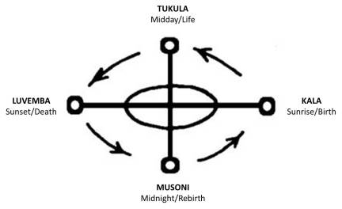
Circle of Culture

Slide 12
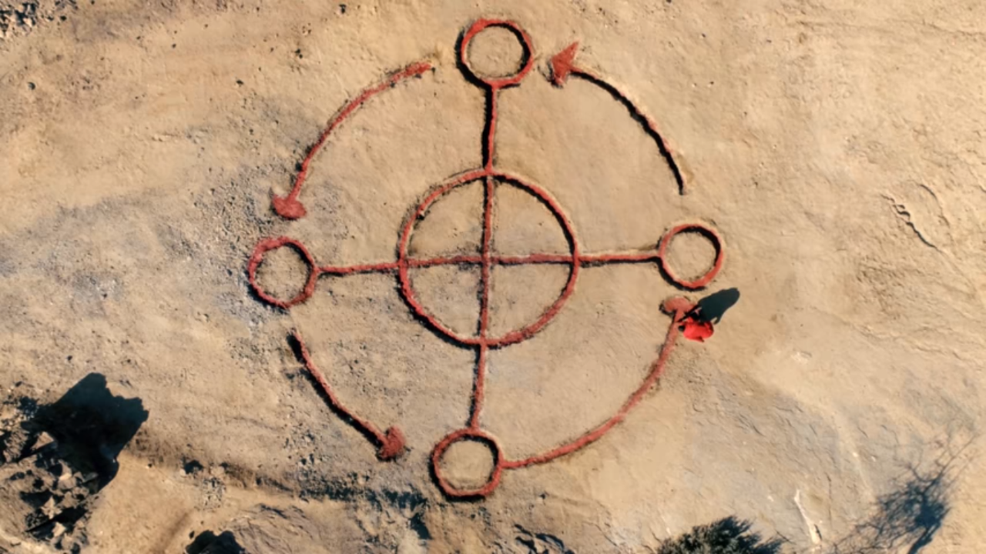
https://youtu.be/Y42KUkKfNQA
Notes:
https://youtu.be/Y42KUkKfNQA

Slide 13
http://www.ayanetwork.com/aya/vincentharding/
Page 10-13
Page 17-18
Notes:
https://youtu.be/Y42KUkKfNQA

Slide 14
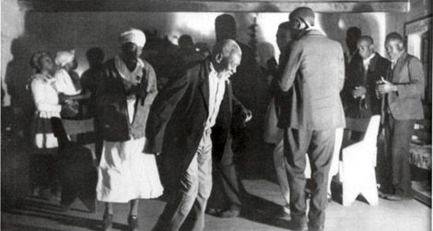
Circle of Culture
Notes:
Doing the Ring Shout in Georgia, ca. 1930s Members of the Gullah community express their spirituality through the “ring shout” during a service at a local “praise house.” (Image courtesy of Lorenzo Dow Turner Papers, Anacostia Community Museum Archives, Smithsonian Institution)

Slide 15
Family | Kinship: “I'm never alone..”
Mama
Baba
Marriages
Cousins

Slide 16
Circle of Culture

Slide 17
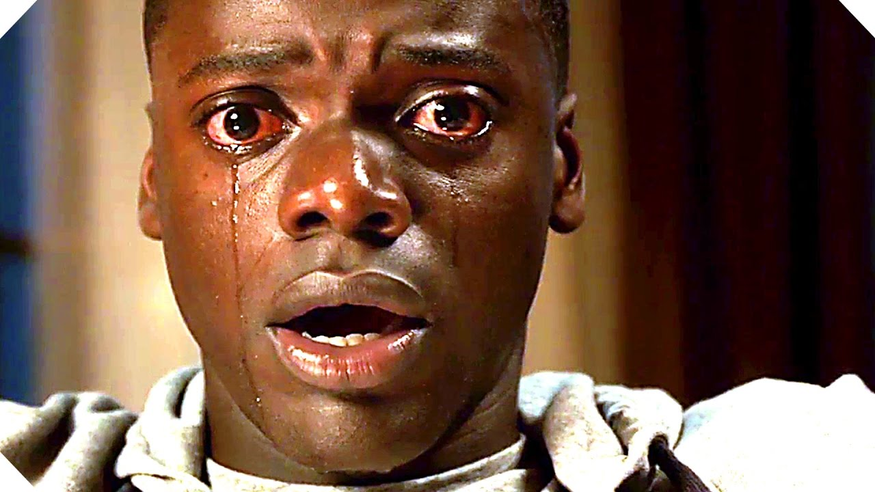
Blind: With eyes wide-open: Cultural Misorientation

Slide 18
Discover the real connections we have to that MAAFA experience and story - both his-story and our-story of it.
New strategy: Not suppression. Rediction Mind your wants. Power?

Slide 19
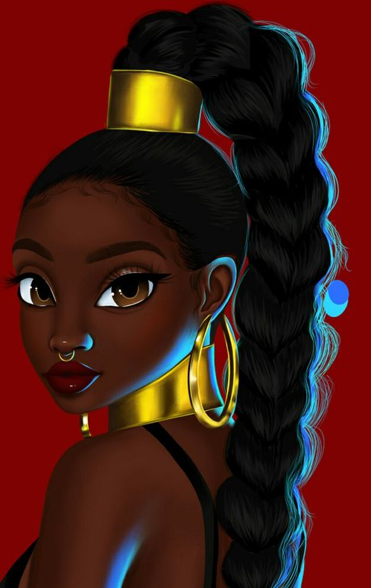
Today our eyes and our stories are scripted. We must counter these for redemption.
MSO -Morality in Service of Oppression
UBO - Universal Black Orphan
SHT - Superior Hero Trap (From
STD - Same The Devil (The Massacre)
GWS - Great White Savior (Harriet Tubman)

Slide 20
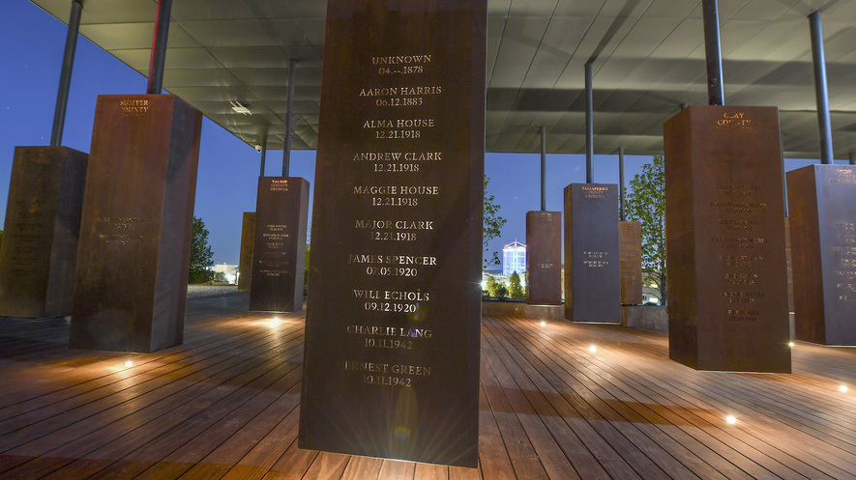
STD
Shame The Devil - infects our honoring our dead.

Slide 21
Family ritual to read through the African captive narratives to seek a better understanding of what our ancestors went through to keep us grounded and reminded of our responsibility/accountability to them.
Went through +
What did we do to endure it, flip it, and end it?
Notes:
Narratives: Stories
Grounded to what? For What?
What is our responsibility to them?
What are we to be held accountable for?

Slide 22
MSO STD

Slide 24
MSO STD
Shame The Devil - infects our honoring our dead.
Delusion - STD - delusion of power, disguises surrender
The root of delusion is fear! (Amos Wilson)

Slide 25
We're a Winner - Curtis Mayfield
Motivation
Call and response (community to artist, artist to community...
Calling for deeper level of committment

Slide 26
Say It Loud - James Brown
Motivation
Call and response (community to artist, artist to community...
Calling for deeper level of committment?
How do we call that and nurture that in our community?

Slide 27
King of Love is Dead - Nina Simone
Motivation
Call and response (community to artist, artist to community...
Calling for deeper level of committment

Slide 28
The Tulsa Massacre?

Slide 29
Not! can't call it a massacre!

Slide 30
Emotional suppression / redirection

Slide 31
Melanin - Core?

Slide 34
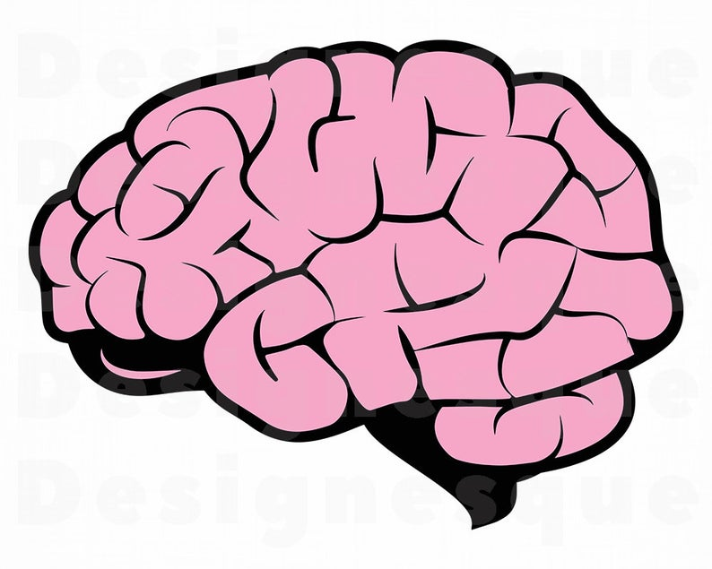
Neuromelanin
Neuromelanin is melanin in the brain.

Slide 35
Melanin has 3 functions.
Antioxidant
2. Nerve Conduction Facilitator
3. Energy transformer

Slide 36
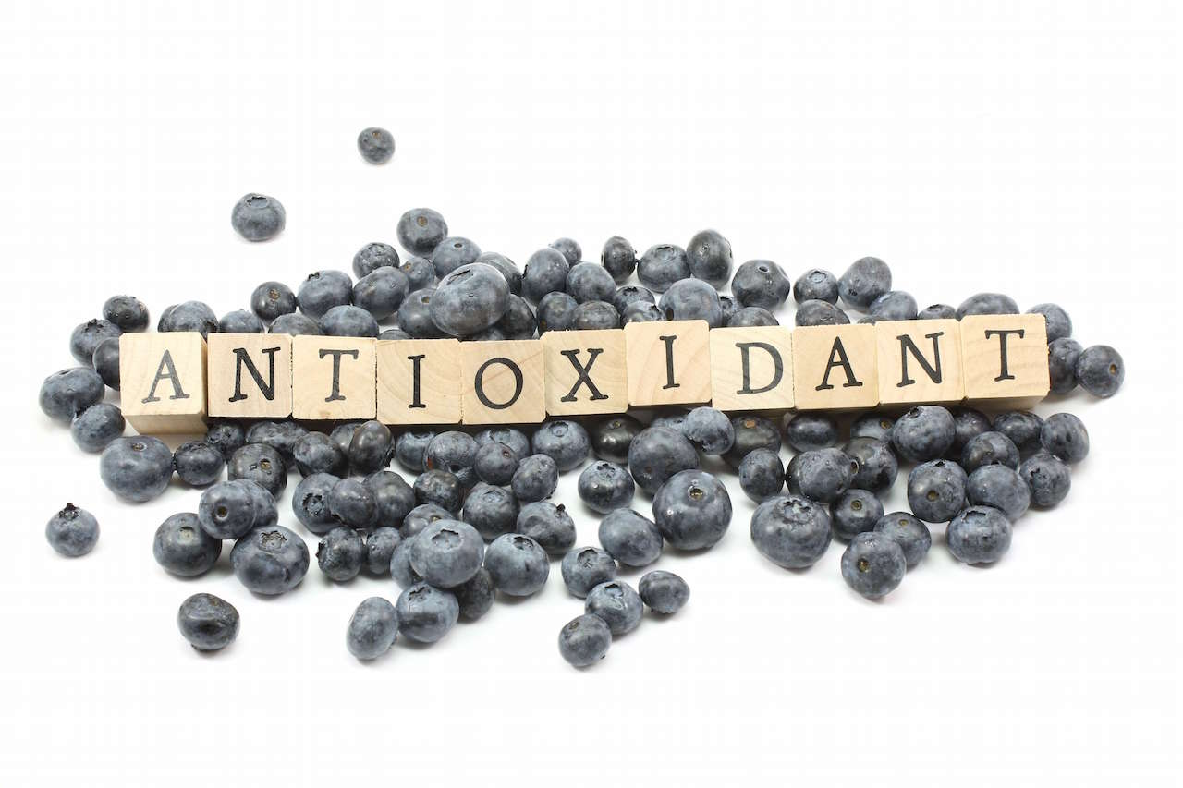
Antioxidant
Antioxidants are substances that protect cells against free radicals.
As an antioxidant, melanin prevents free radicals from forming in the body.
Oxidation in the body creates higher risks for cancer and heart disease.

Slide 37
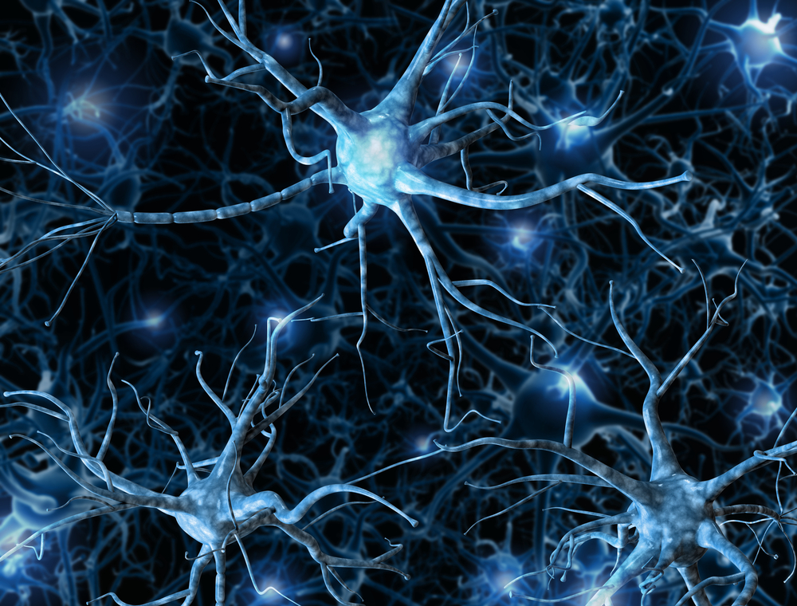
Nerve conduction facilitator
Melanin helps to send nerve signals in the body.

Slide 38
Energy Transformer
Melanin converts sound waves and heat. It converts sound waves into impulses and light into light energy.

Slide 39
Melanin and the Skin

Slide 40
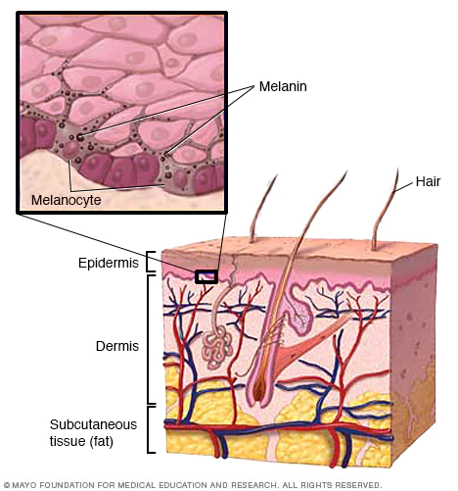
Melanin: Beneath the Surface
Melanin is in almost every organ of the body including the skin, which is the largest.
The skin is comprised of three layers: the dermis, epidermis, and the hypodermis.
Melanin, which is produced by melanocytes and melanosomes, is found in the lowest layer of the epidermis.

Slide 41
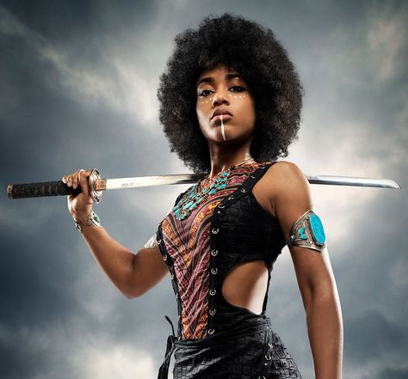
Melanin: The Great Protector
Melanin acts as a natural sunscreen, protecting skin from the harmful ultra-violet (UV) rays of the sun.
Melanin absorbs the UV rays radiation and converts them into energy for the body.
While melanin absorbs UV rays, which contribute to melanoma and other skin diseases, it can sometimes inhibits the production of bone-strengthening Vitamin D.

Slide 42
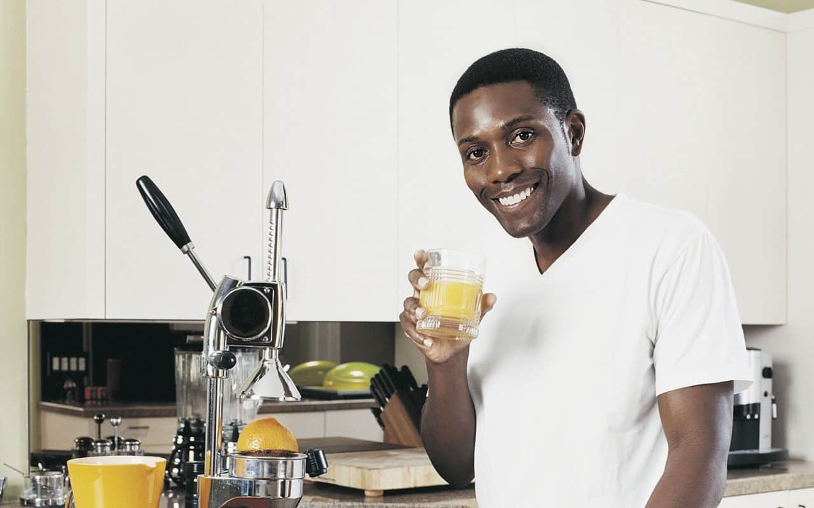
Afrikan People and Vitamin D (cholecalciferol)

Slide 43
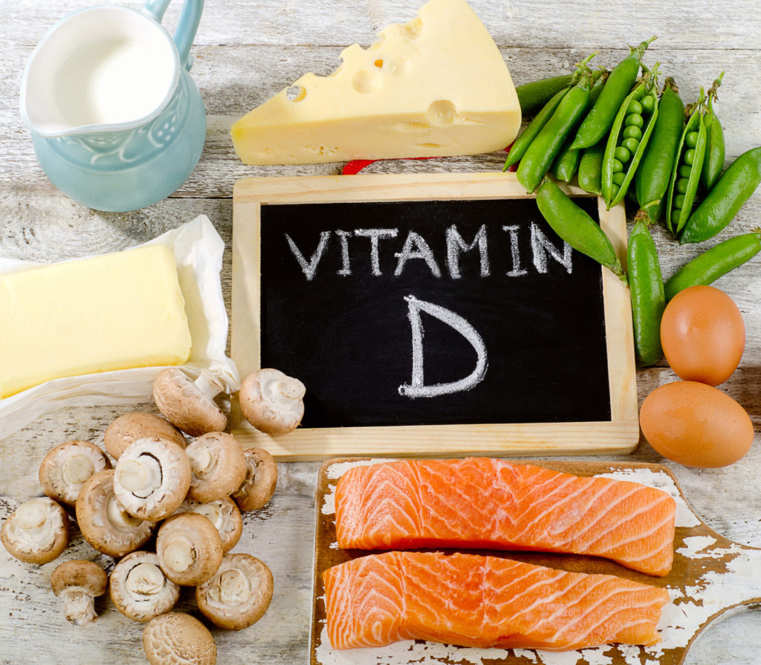
Melanin and Vitamin D
While melanin is at work shielding skin from harmful skin conditions, Vitamin D is being activated by the sun.
Vitamin D, scientifically named cholecalciferol, is a nutrient that works to strengthen bones by absorbing calcium from food.
Melanin makes it difficult for the body to absorb UV radiation and activate Vitamin D. As a result, more melanated people have been believed to be Vitamin D deficient.

Slide 44
The Dilemma
For years, many doctors believed that black people—the most melanated people on the planet—were Vitamin D deficient and had poor bone health. This is not the case.
Afrikan people have the strongest bones of any race.
How can this be?

Slide 45
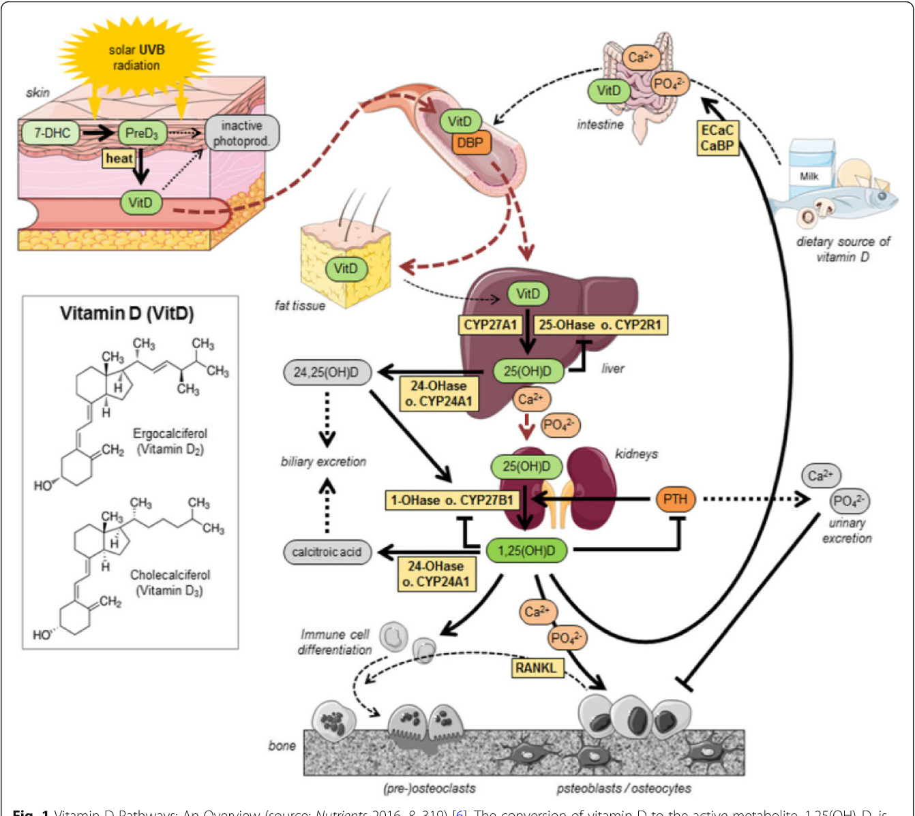
The Vitamin D Paradox
How can African people be Vitamin-D deficient and still have the strongest bones of any race ?

Slide 46
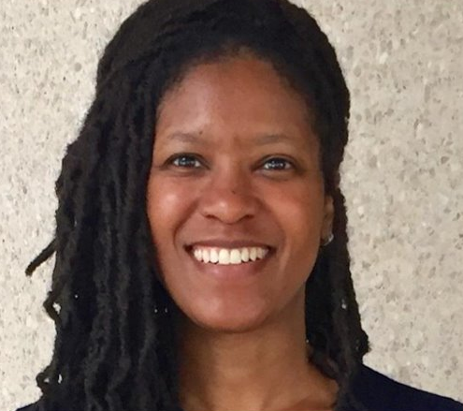
What is the Vitamin-D Paradox?
The Vitamin-D paradox, studied by NIH scientist Dr. LaVerne Brown and colleagues, found that Black people have less Vitamin D than other races yet have the strongest bones.
In fact, "the National Institute of Health found...that African-Americans had deficient or markedly low levels of vitamin D, but still had lesser incidences of osteopenia, fractures, or falls as opposed to white Americans."
It didn’t make sense. If Black people were Vitamin-D deficient but still had strong bone density, the tests must be wrong.
Afrikan people were being misdiagnosed.

Slide 47
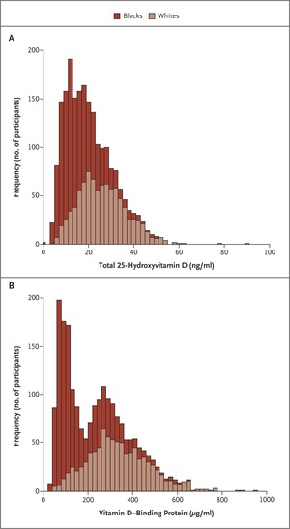
Getting it right
The Tests Measure Difference, Not Deficiency
The tests doctors use to determine Vitamin D deficiency measure the protein 25-hydroxyvitamin-D 25(OH)D, which is more commonly found in Caucasians. This protein is used to store Vitamin-D for later use.
Black people, who lived closer to the equator, had no use for this protein and therefore didn’t produce it. In fact, Black people only have a quarter of the amount of this protein than white people have.
So the tests only detected a decreased amount of 25(OH)D, not the Vitamin D that determines bone health.
However, studies conducted by Dr. Robert Thadhani determined that Black people have enough of 1,25 Di-hydroxyvitamin-D and don’t need the other protein. This is why our bones are still strong, despite what the Vitamin D tests suggest.
Afrikan people are not Vitamin-D deficient!

Slide 48
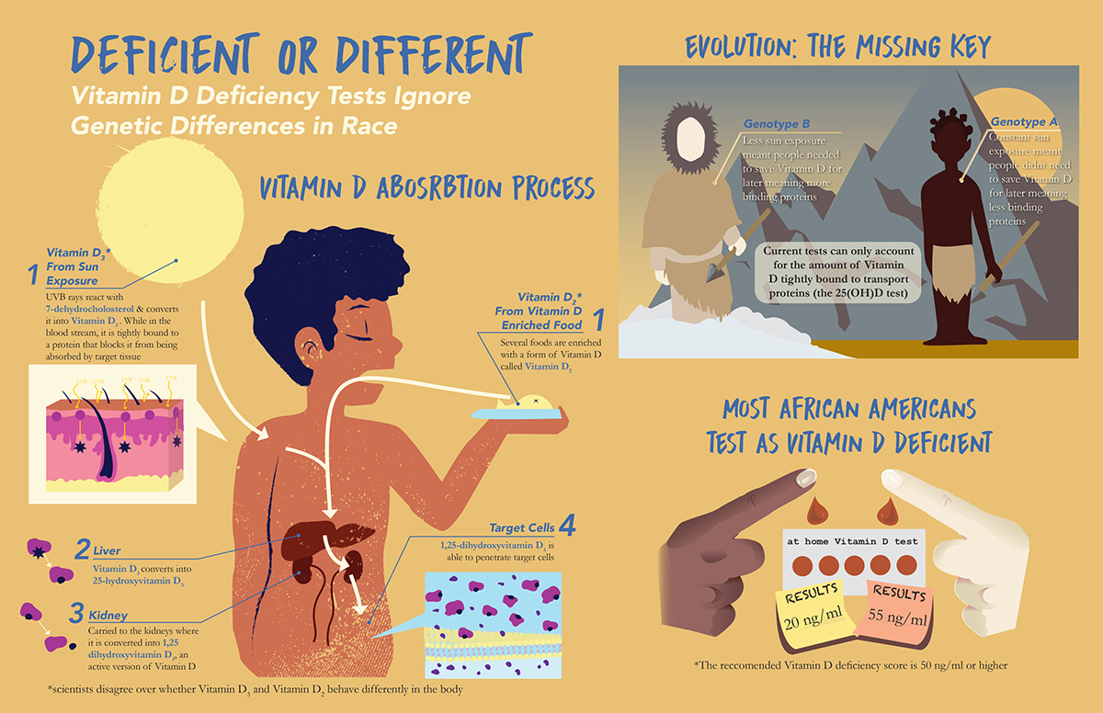

Slide 49
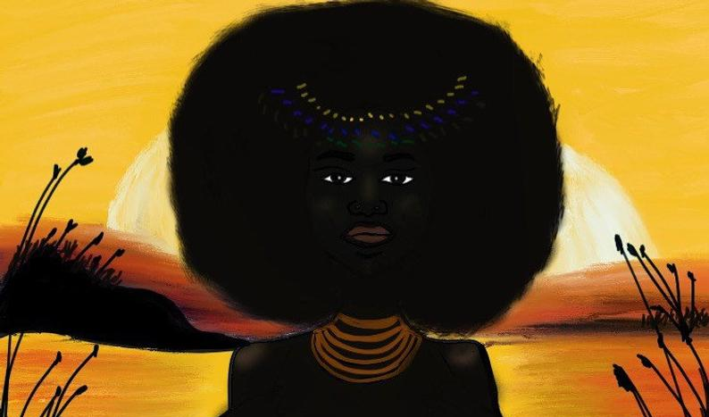
Conclusion
For many years, doctors throughout the world have told African people that they were Vitamin D deficient and, as a result, had poor bone health. Some have conducted limited research to justify their beliefs. However, scientists like Dr. LaVerne Brown proved the tests have been wrong all along.
Black people have always had enough and sometimes even more Vitamin D than Caucasians or other less-melanated people.
Our bones are stronger than any other race, and we have less incidences of osteoporosis, osteomalacia and other bone issues.
Each genotype needs a specific test to determine if they are Vitamin-D deficient. To properly determine if Afrikan people are vitamin-D deficient, we must be given tests designed for us, ones that check for 1,25 dihydroxyvitamin D, not the 25-hydroxy form. We can’t continue to be misdiagnosed, potentially poisoning ourselves with Vitamin D supplements, and believing our melanin is the blame.

Slide 50
Vocabulary
Cholecalciferol – Scientific name for Vitamin D​, a nutrient that absorbs calcium in the body.
Deficiency – The lack of something.
Free radicals – A radical is an atom, molecule, or ion that has an unpaired valence electron.
Genotype – The genetic constitution of an individual organism.
Melanosomes – An organelle found in animal cells and is the site for synthesis, storage and transport of melanin, the most common light-absorbing pigment found in the animal kingdom.
Osteomalacia – Softening of the bones, typically through a deficiency of vitamin D or calcium.​
Oxidation – The loss of electrons during a reaction by a molecule, atom or ion.
Paradox – A seemingly absurd or self-contradictory statement or proposition that when investigated or explained may prove to be well founded or true.
Osteoporosis – A condition in which bones become weak and brittle.
Tyrosinase – An enzyme that controls melanin production.

Slide 51
Citations
Brown, LaVerne L., et al. "The vitamin D paradox in Black Americans: a systems-based approach to investigating clinical practice, research, and public health-expert panel meeting report." BMC proceedings. Vol. 12. No. 6. BioMed Central, 2018.
Dhaliwal, Ruban, et al. "The relationship of physical performance and osteoporosis prevention with vitamin D in older African Americans (PODA)." Contemporary clinical trials 65 (2018): 39-45.
Hameed A, Akhtar N. (2019). The Skin Melanin: An Inhibitor of Vitamin-D3 Biosynthesis: With Special Emphasis with Structure of Skin. A Mini Review. Dermatol Case Rep 4: 149.
Knox, R. ( 2013). How A Vitamin D Test Misdiagnosed African-Americans. The New England Journal of Medicine. Retrieved from npr.org/sections/health-shots/2013/11/20/246393329/how-a-vitamin-d-test-misdiagnosed-africanamericans.

Slide 52
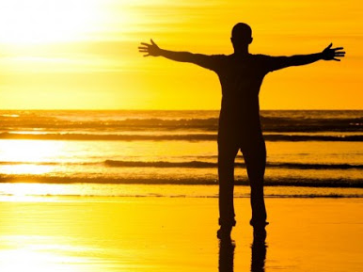
Nair, Rathish, and Arun Maseeh. “Vitamin D: The sunshine vitamin.” Journal of pharmacology &amp; pharmacotherapeutics vol. 3,2(2012): 118-26. doi:10.4103/0976-500X.95506. Riley, P. A. "Melanin." The international journal of biochemistry & cell biology 29.11 (1997): 1235-1239. Slominski, Andrzej, and Arnold E. Postlethwaite. "Skin under the sun: when melanin pigment meets vitamin D." (2015): 1-4. Tolleson W.H. (2009) Melanin and Neuromelanin in the Nervous System. In: Binder M.D., Hirokawa N., Windhorst U. (eds)Encyclopedia of Neuroscience. Springer, Berlin, Heidelberg.
Citations (cont’d)

Slide 53
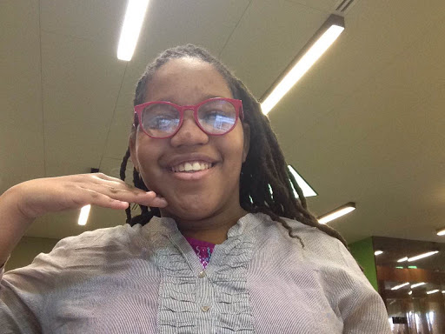
Thank You !!!
Zuri A. Kenyatte, 7th grade
Washington, DC
Age 11

